Slide 1


Automate all the things

Slide 2
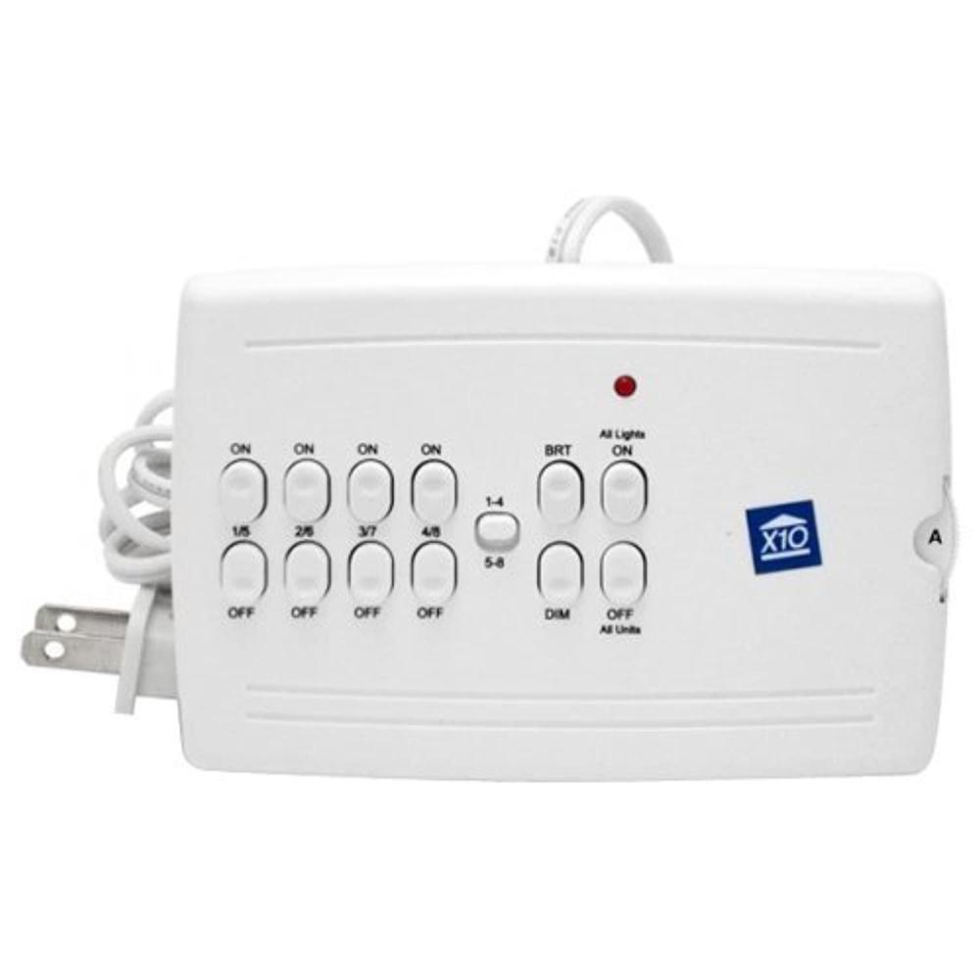
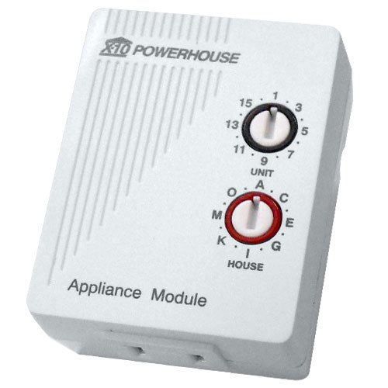


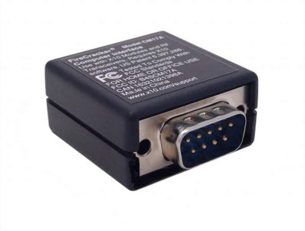
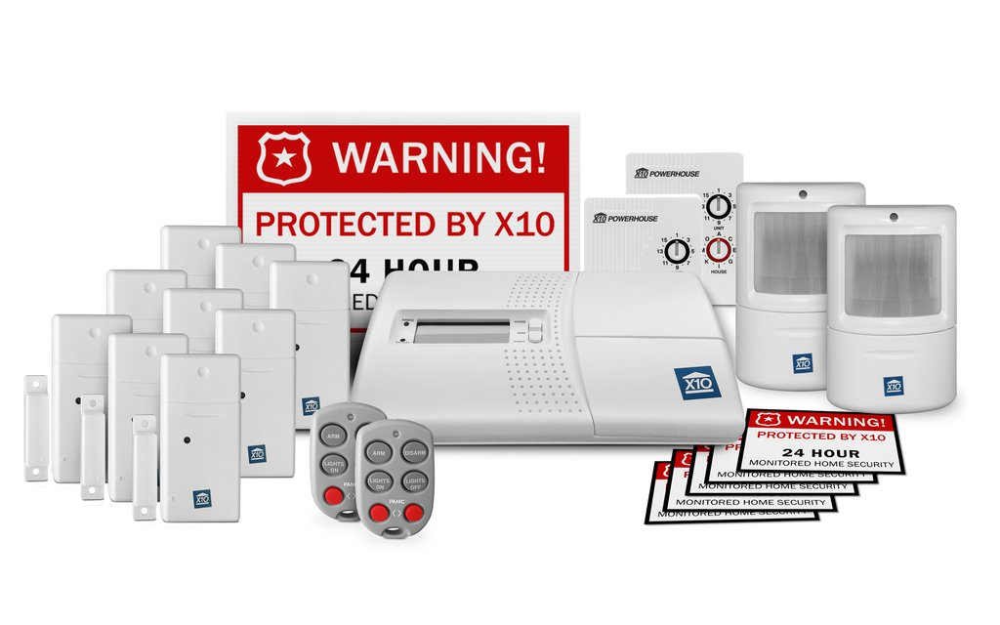
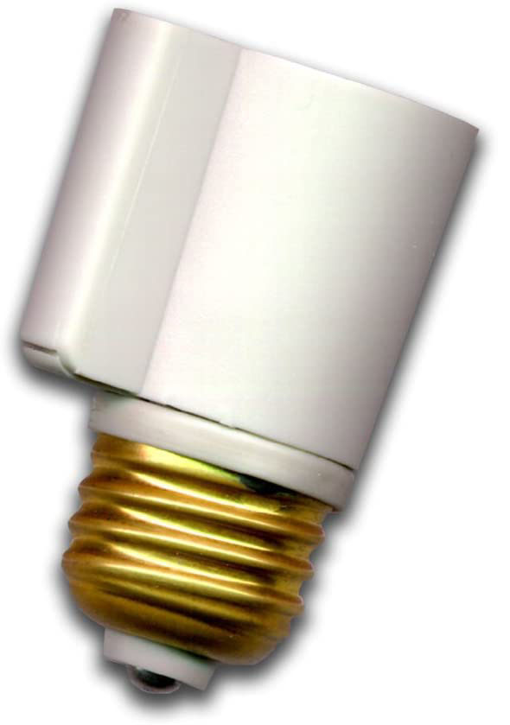
Old School
Notes:
Powerline control signals
20 bits / sec
Signal loss / leakage
Invented 1975 / Available 1978 at Radio Shack and Sears

Slide 3
What can
Notes:
Powerline control signals
20 bits / sec
Signal loss / leakage
Invented 1975 / Available 1978 at Radio Shack and Sears

Slide 4
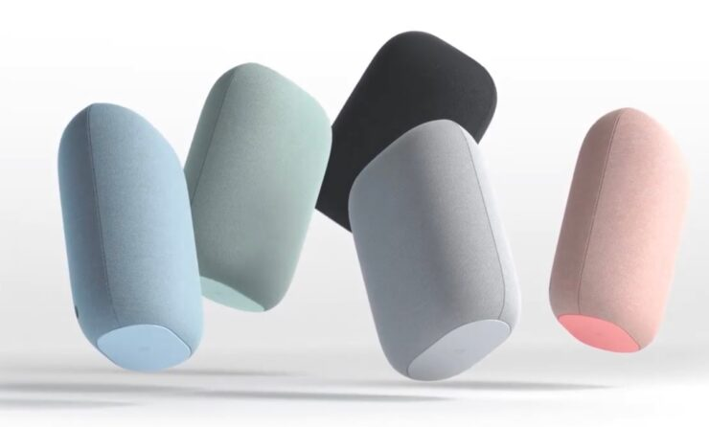





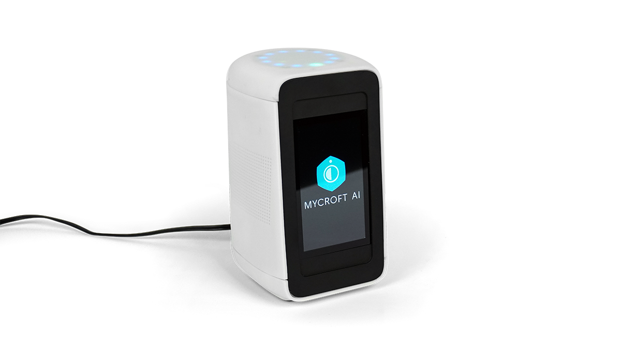

Ecosystems
Amazon
Google
Apple
Open Source
Notes:
Powerline control signals
20 bits / sec
Signal loss / leakage
Invented 1975 / Available 1978 at Radio Shack and Sears

Slide 5



Open Source
Home Assistant
Notes:
Powerline control signals
20 bits / sec
Signal loss / leakage
Invented 1975 / Available 1978 at Radio Shack and Sears

Slide 6

I built a workshop
I needed light, a lot of light

Slide 7
The Problem
I needed light, a lot of light
But what if it’s to much light?
Or what if I need to turn the lights on and I’m stuck in a bear trap miles away?
Or what if all my friends say “You mean you have to use your hands? That’s like a baby’s toy!”
Photo of the inside of the shop at night

Slide 8
The Requirements
Enough light for highly detailed work
Dimmable lights in case the lighting is uncomfortably bright
Integrate with the existing home automation system

Slide 9
The Research
#1 - Enough light for the expected tasks
Read about other people’s shop lighting
Lumens, Foot Candles, and Lux oh my
Decided that 100-150 lumens per sq ft target
Results
23 Lights @ 5,720 lumens each
Total of 131,560 lumens over 800 sq ft
Results in ~ 165 lumens per sq ft

Slide 10
The Research
#2 - Dimmable lights in case the lighting is uncomfortably bright
LED dimming can cause flickering
Use commercial lighting
Decided on 0-10v dimmable lighting

Slide 11
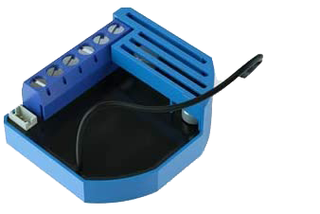
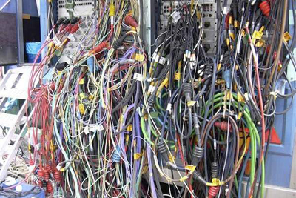
The Research
#3 - Integrate with the existing home automation system
Control options
Qubino 0-10v Z-Wave Dimmer
Roll my own

Slide 12
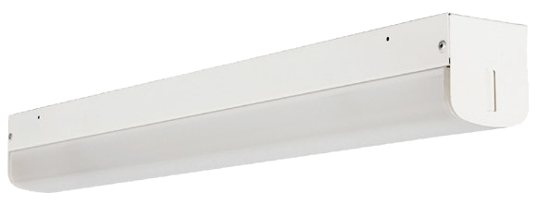
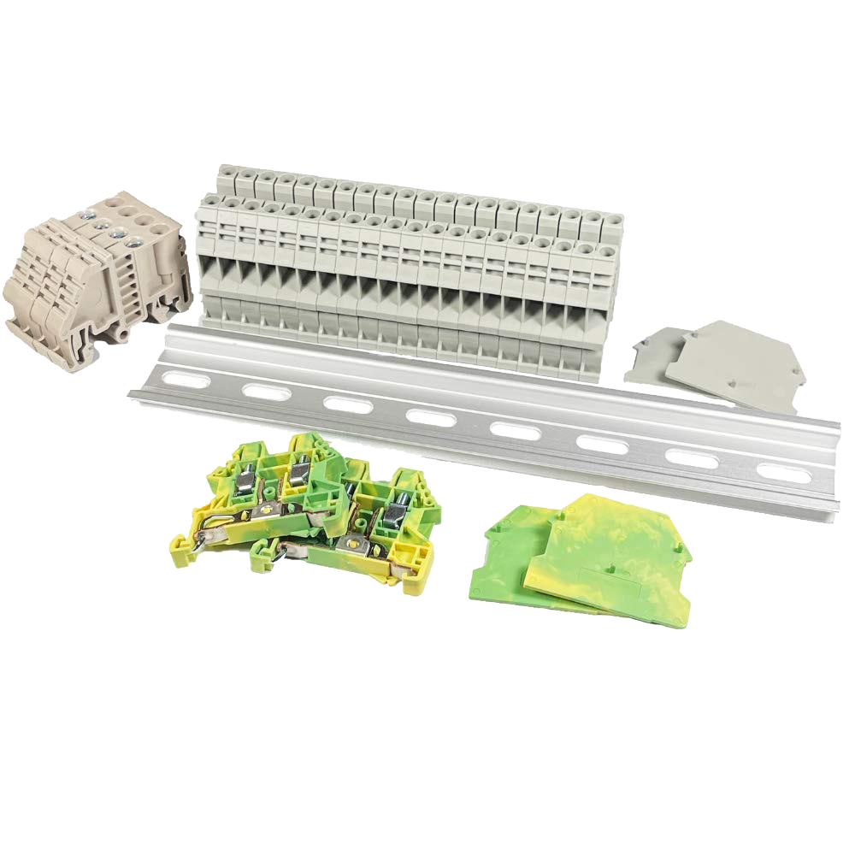

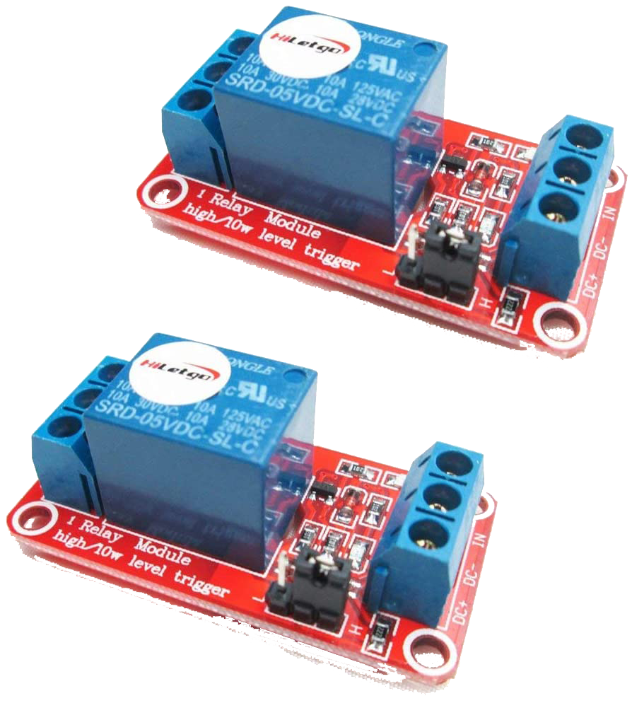
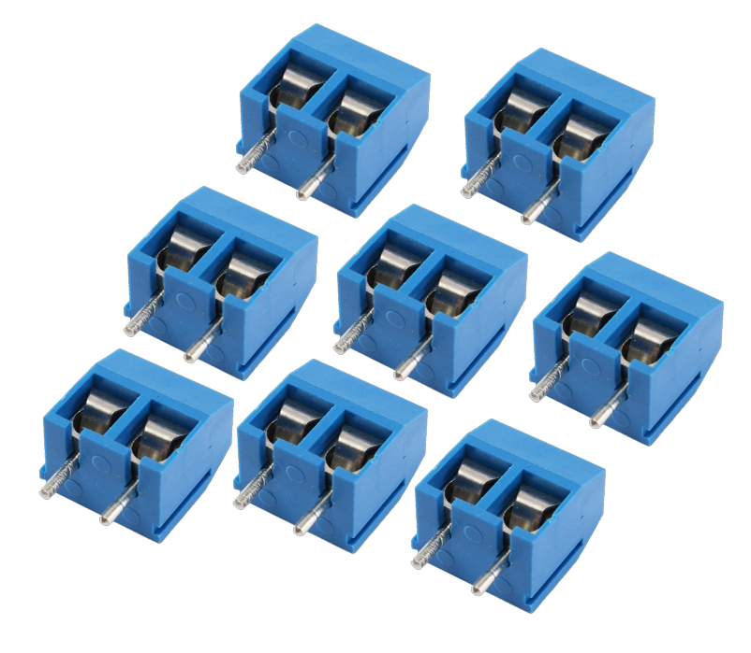
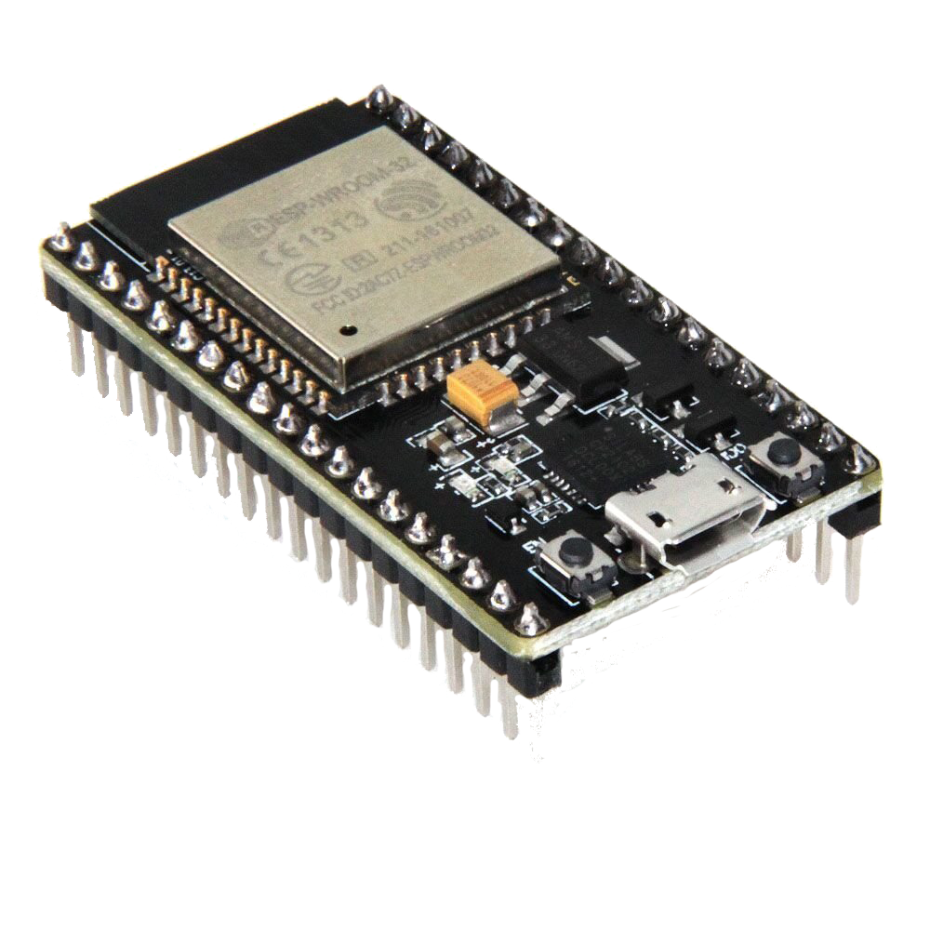
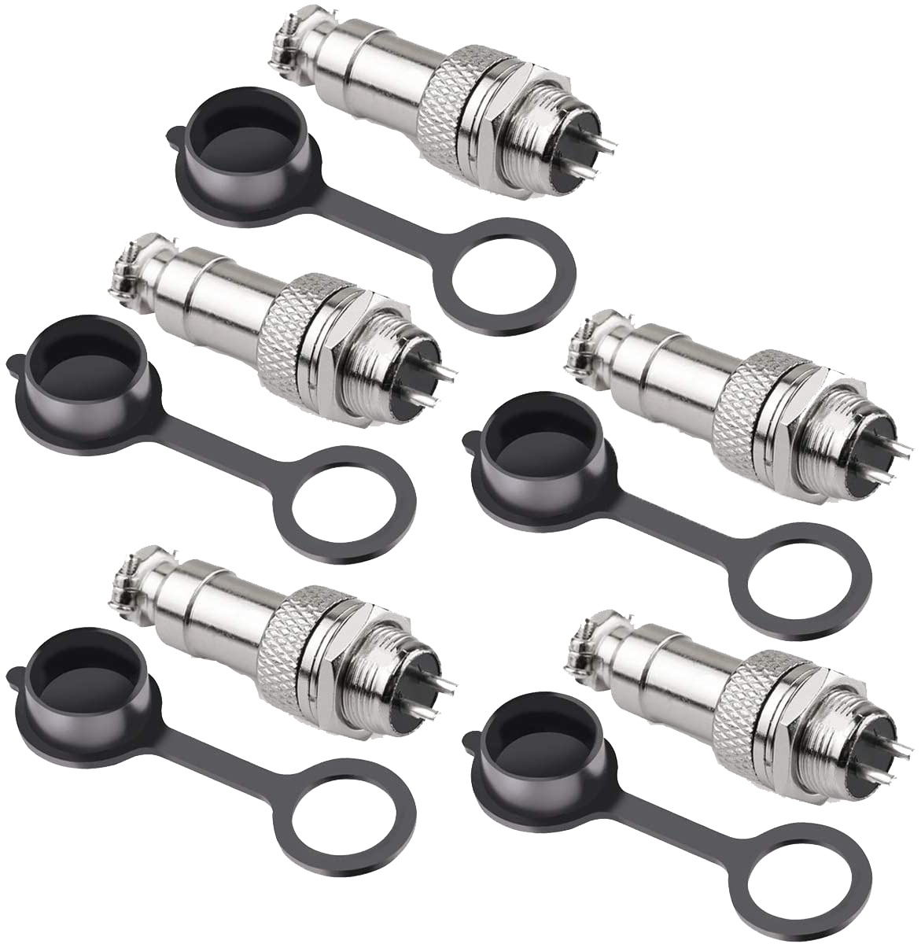
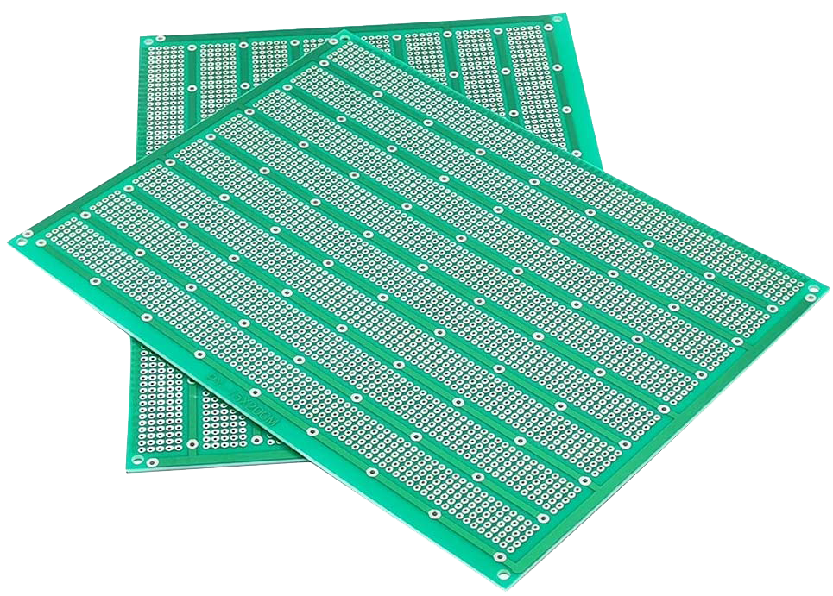
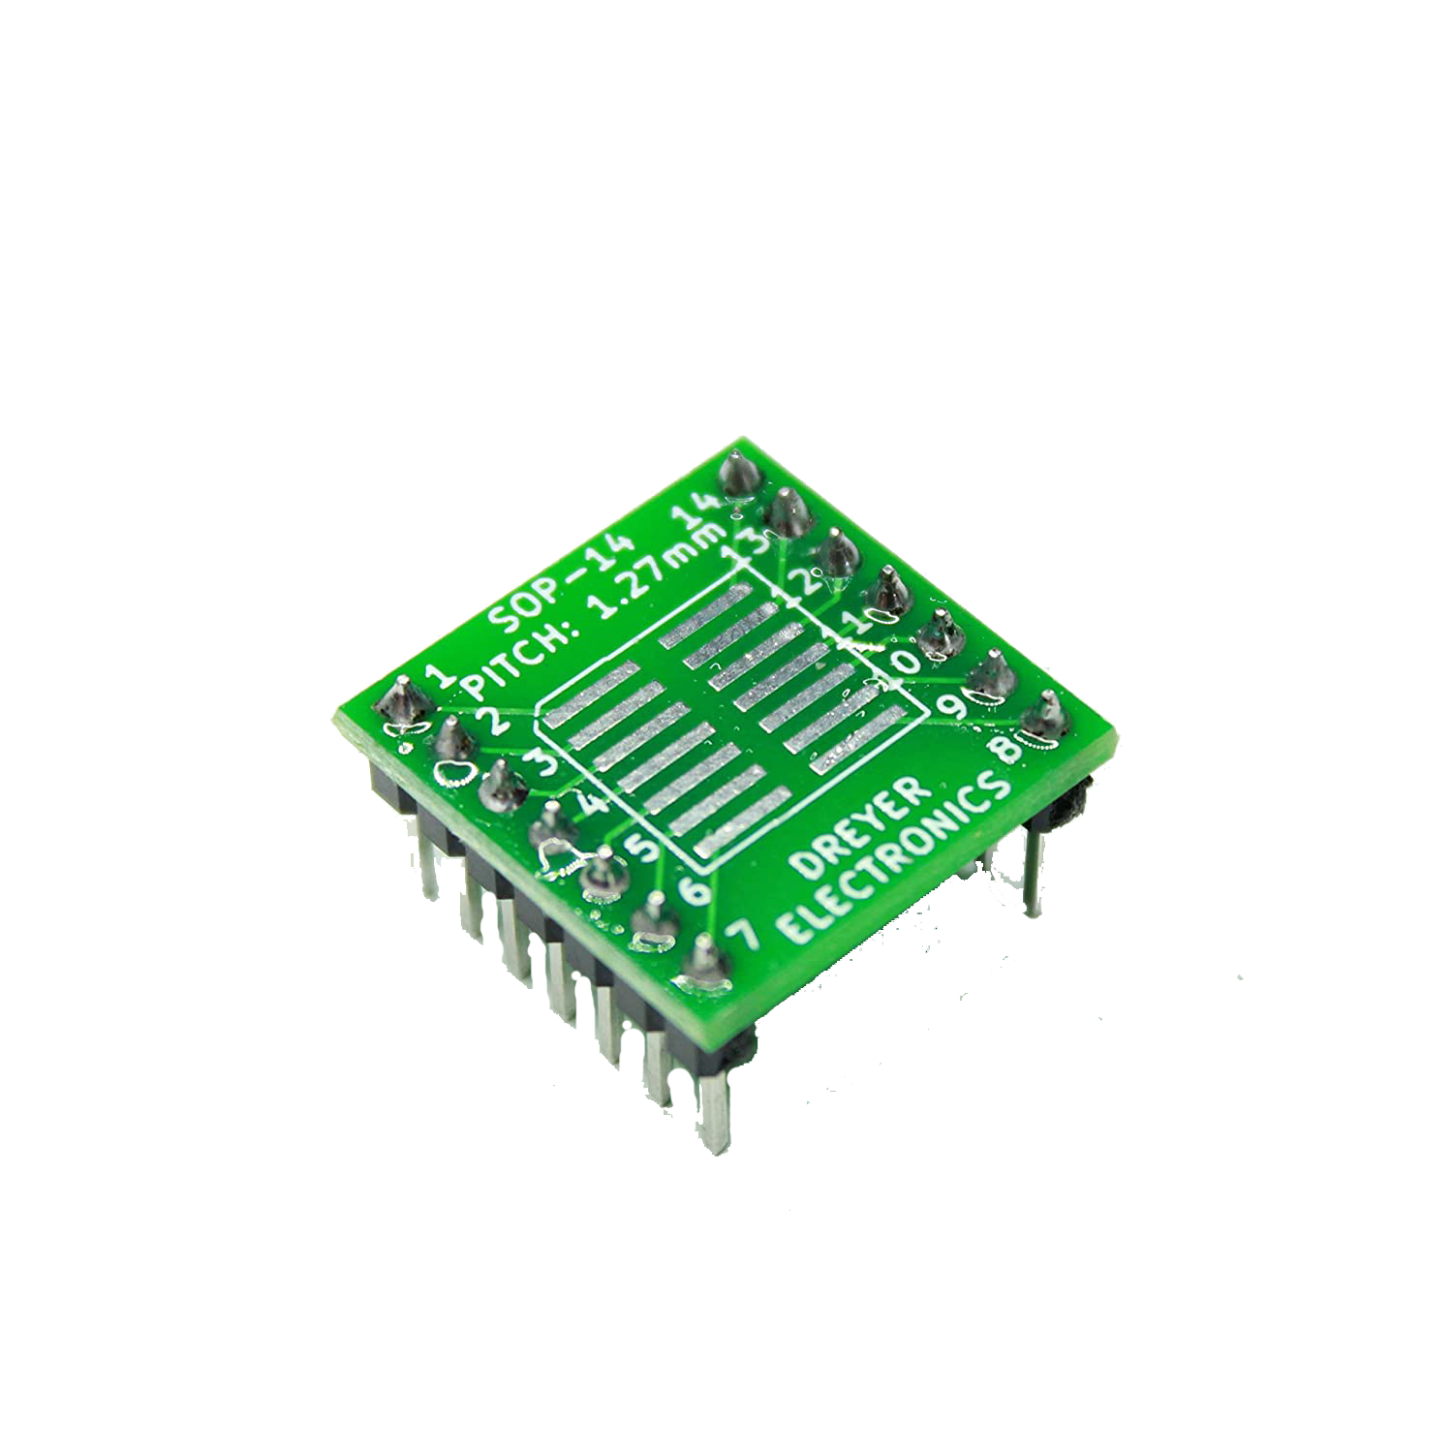
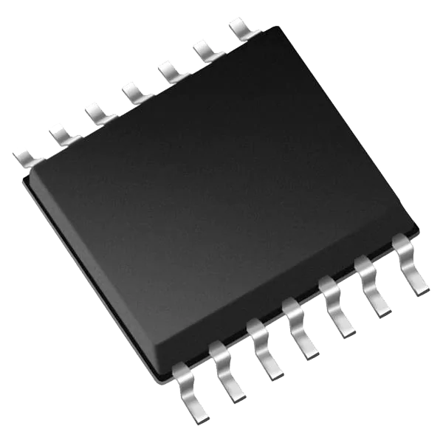
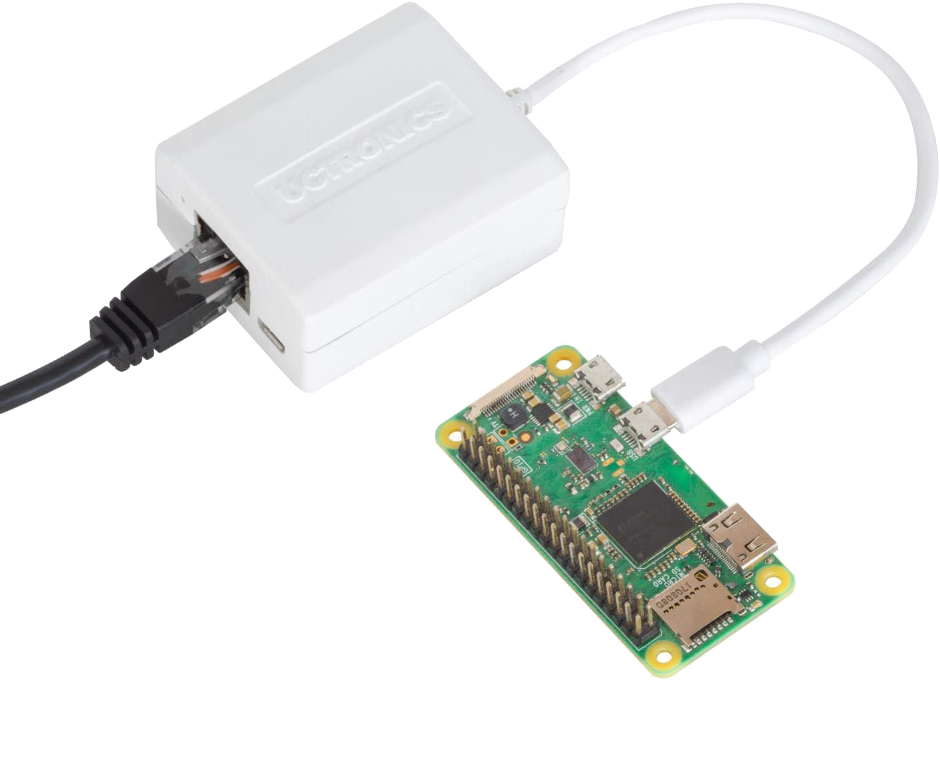
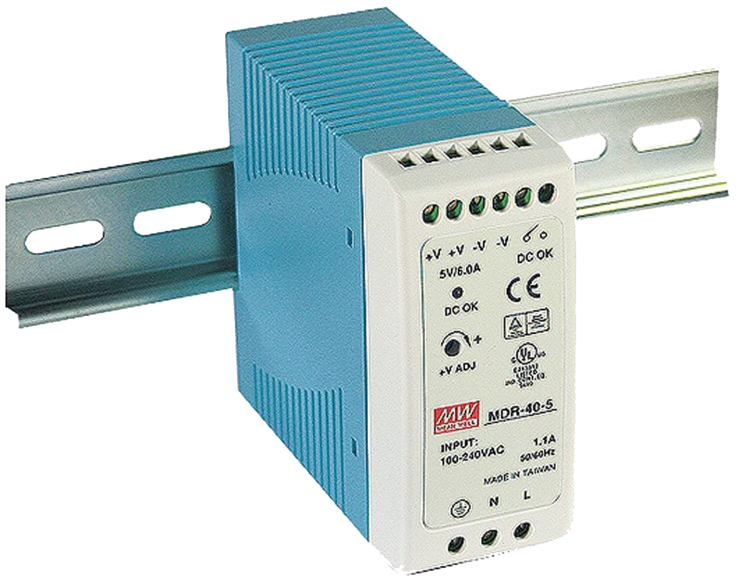
The Parts

Slide 13
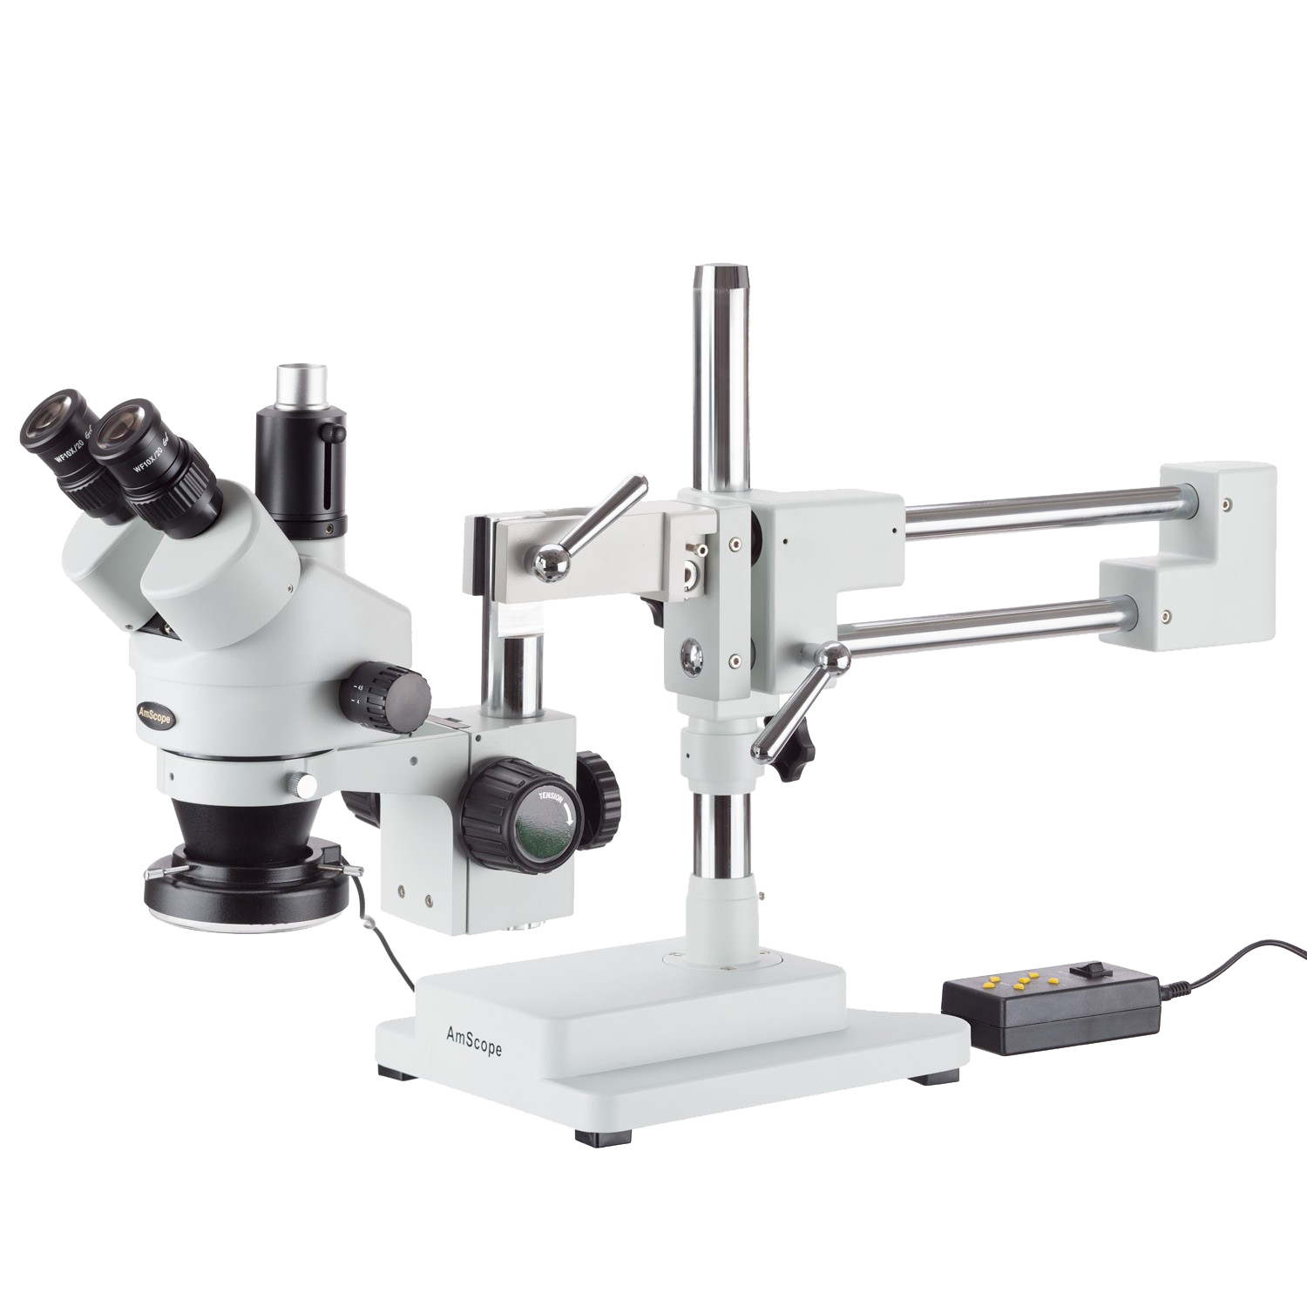
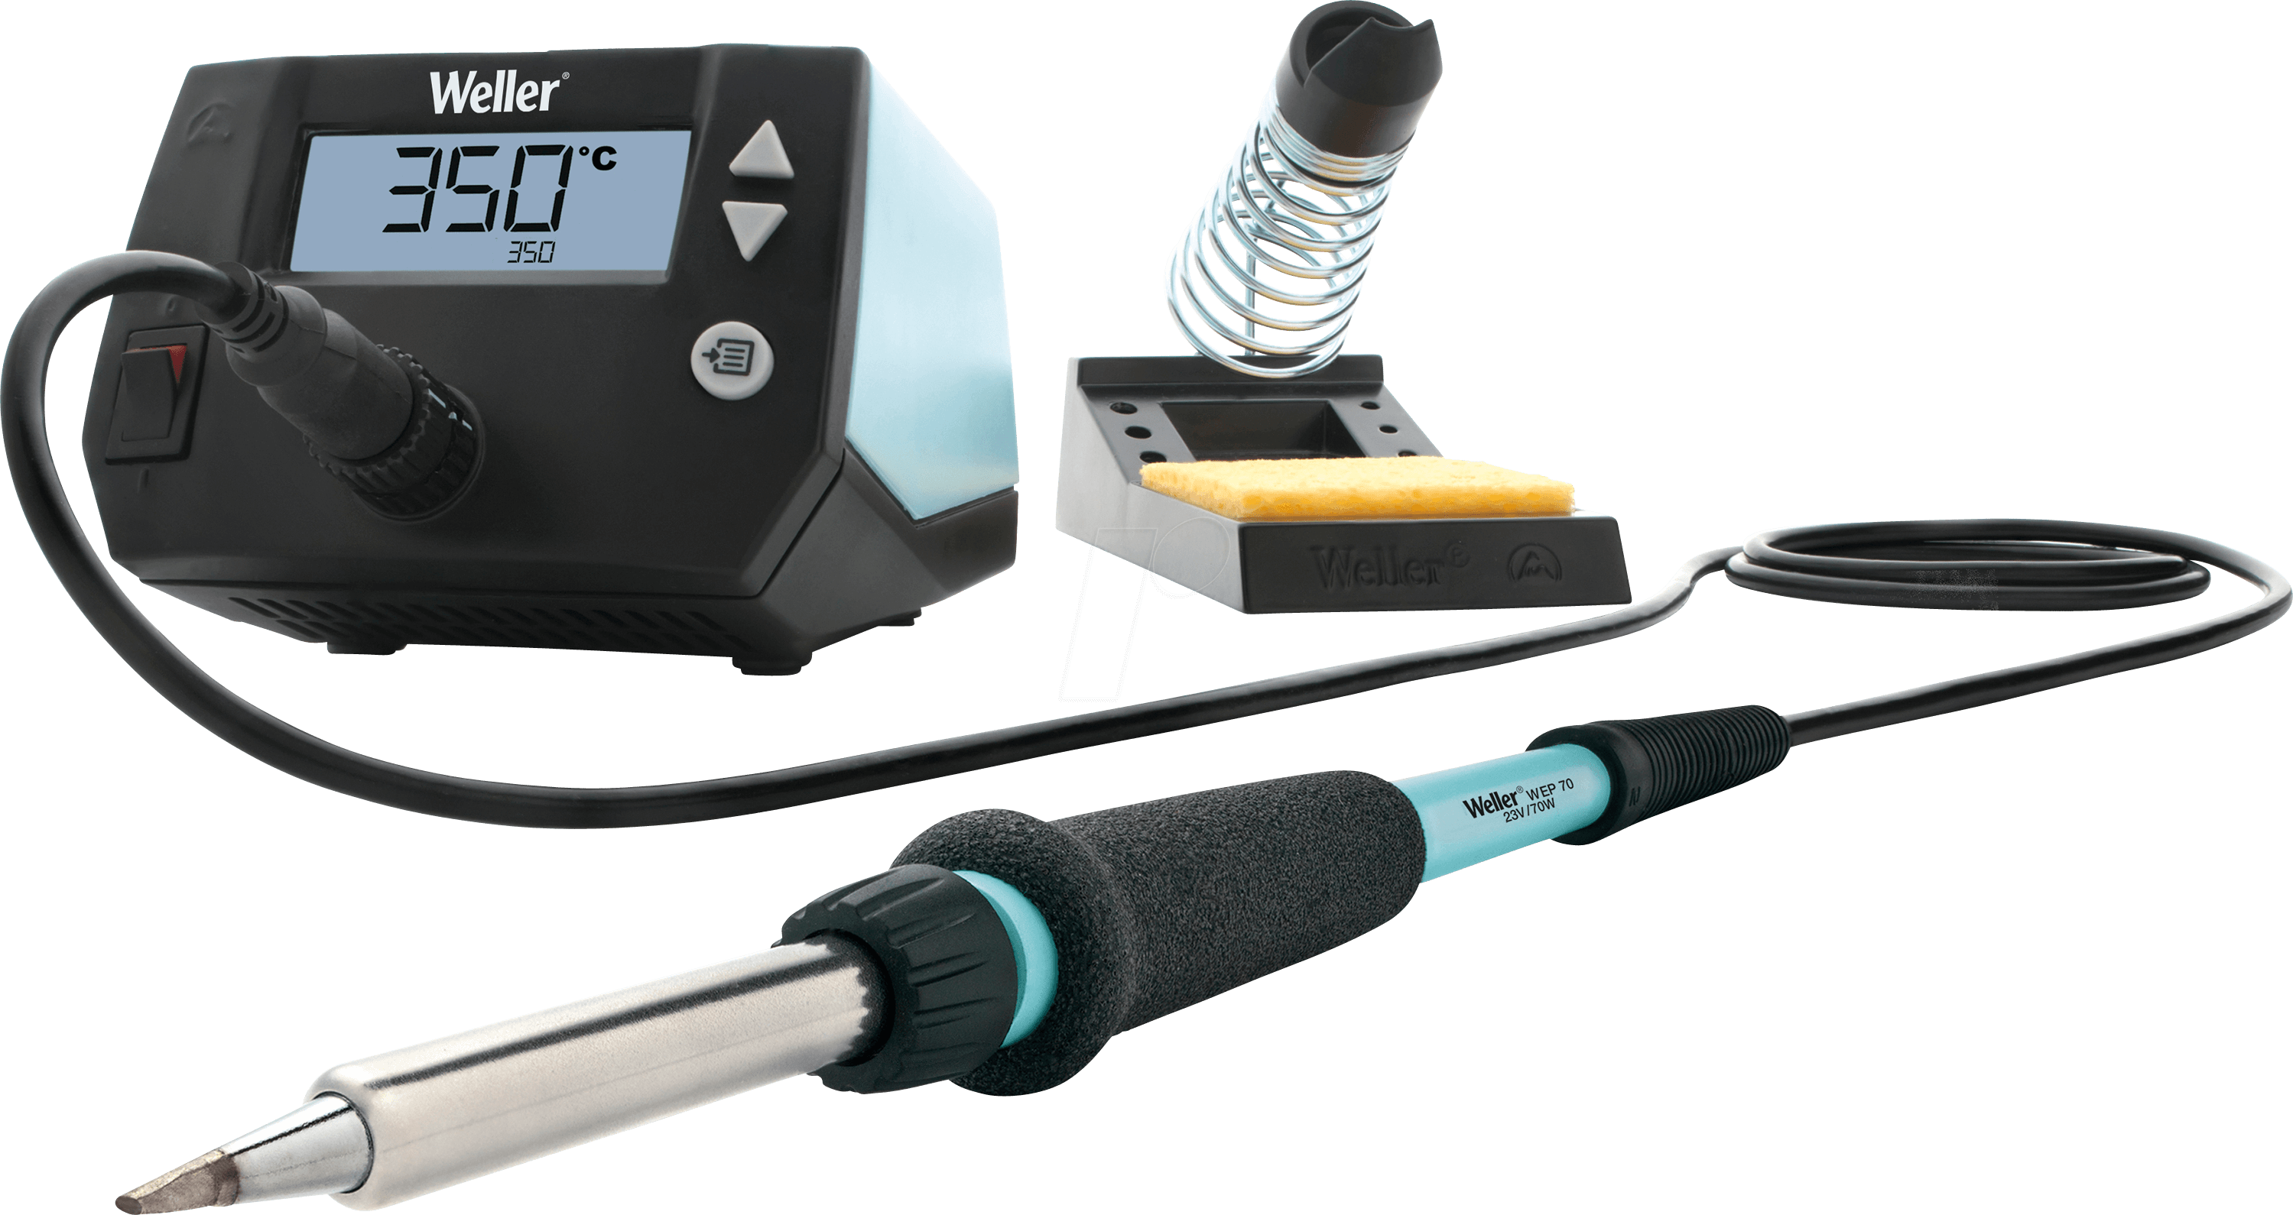


The Process

Slide 14
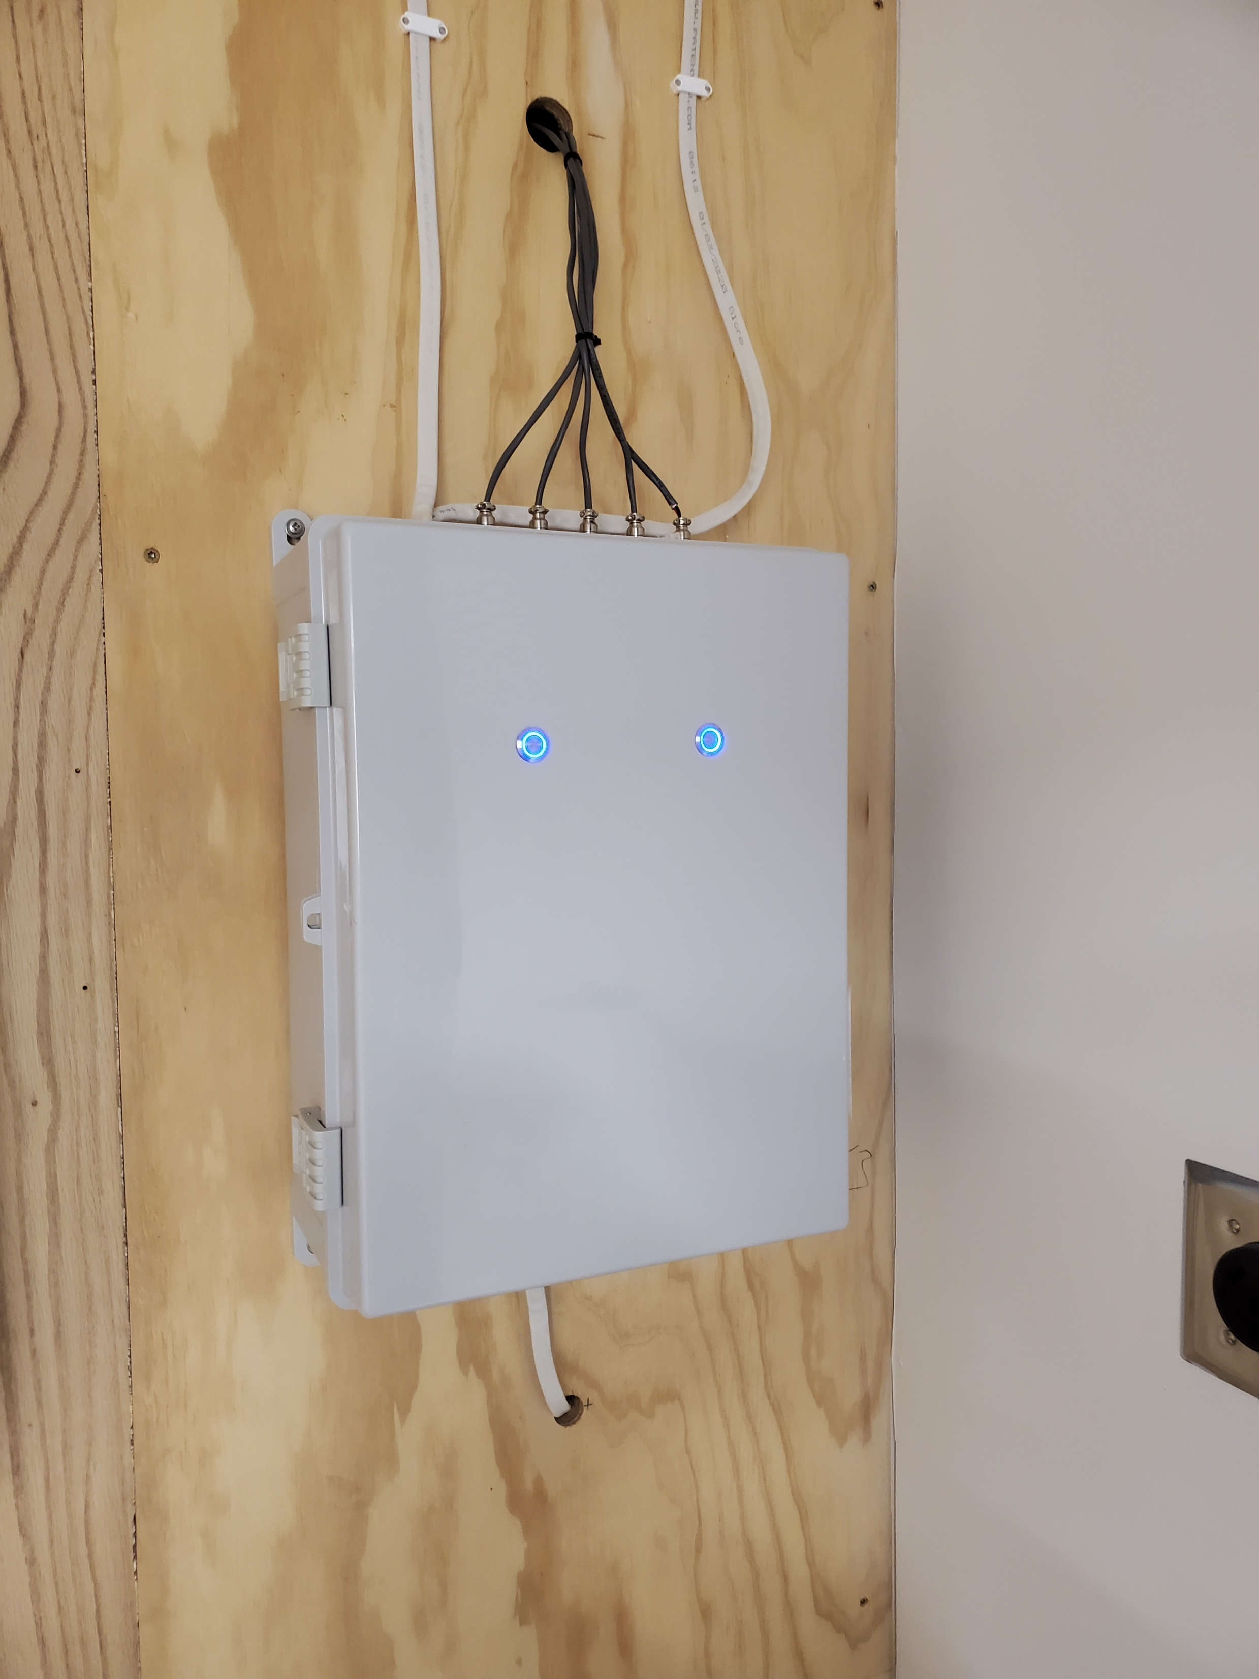
The Results

Slide 15
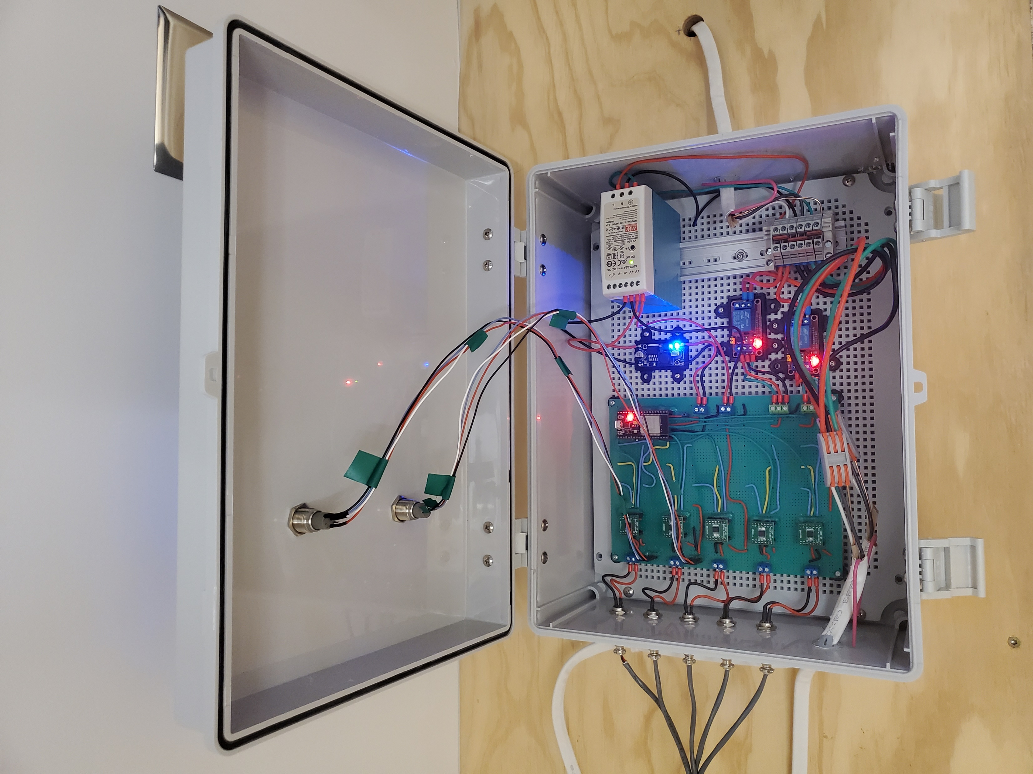

Slide 16
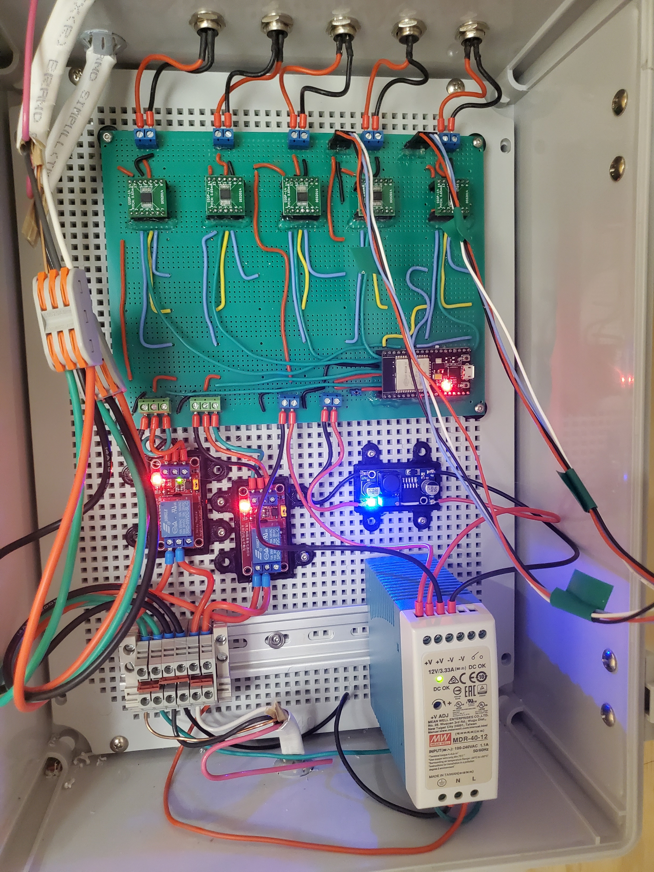

Slide 17
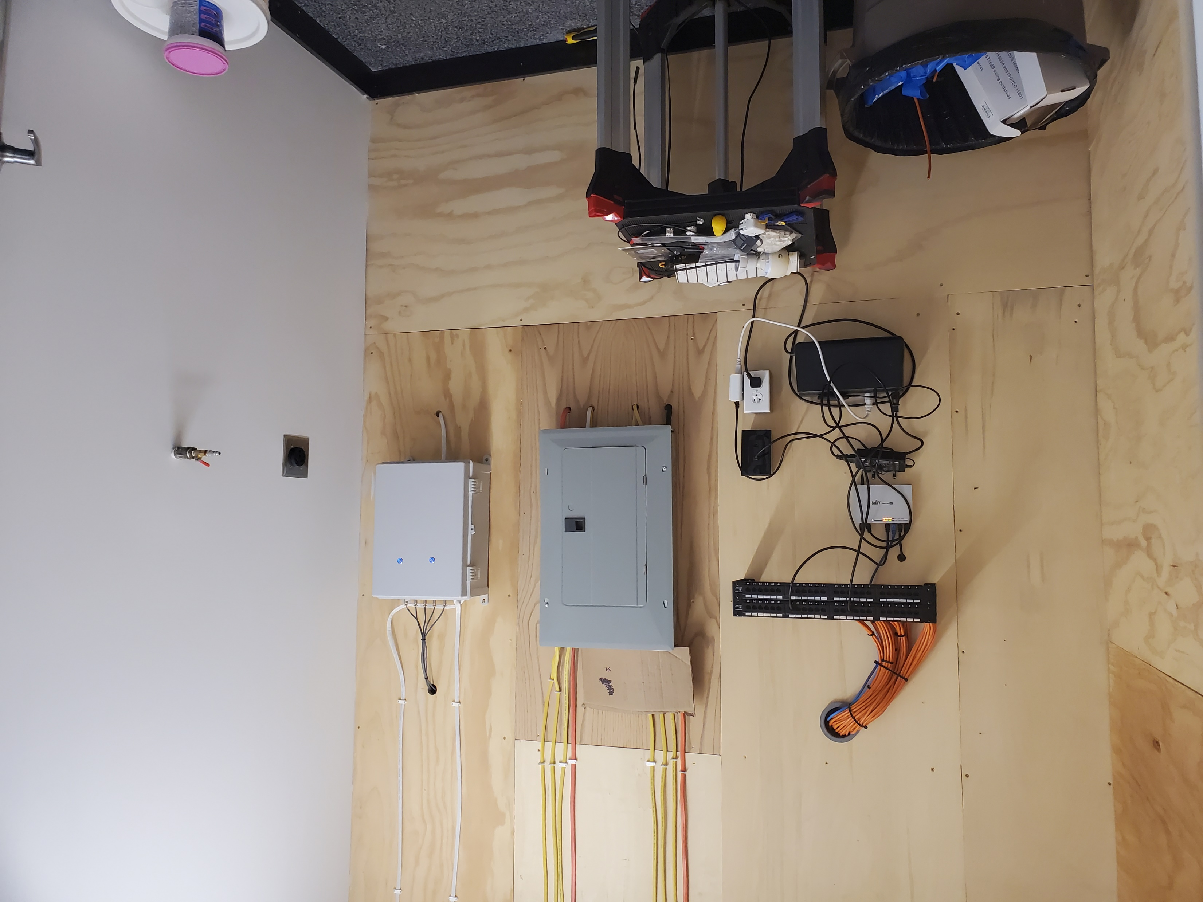

Slide 18
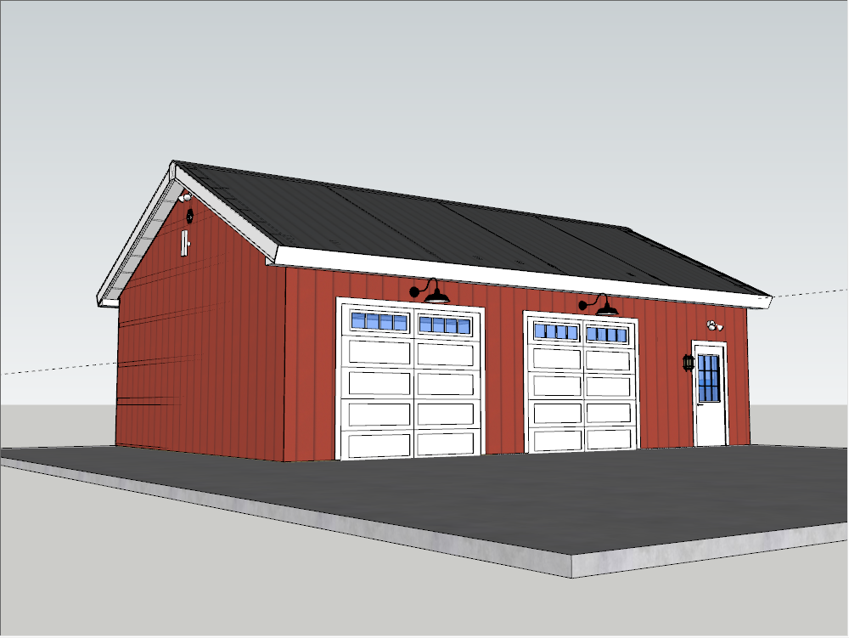
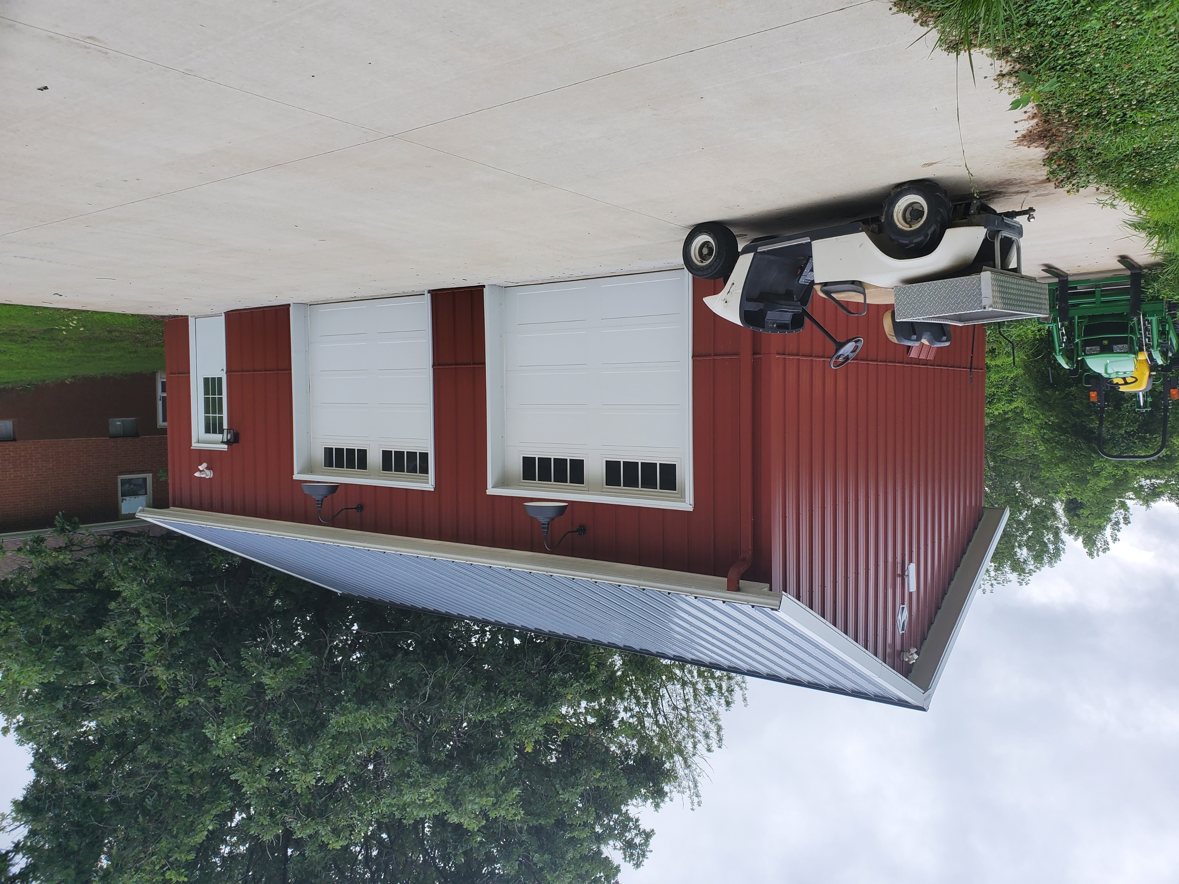
The Shop

Slide 19
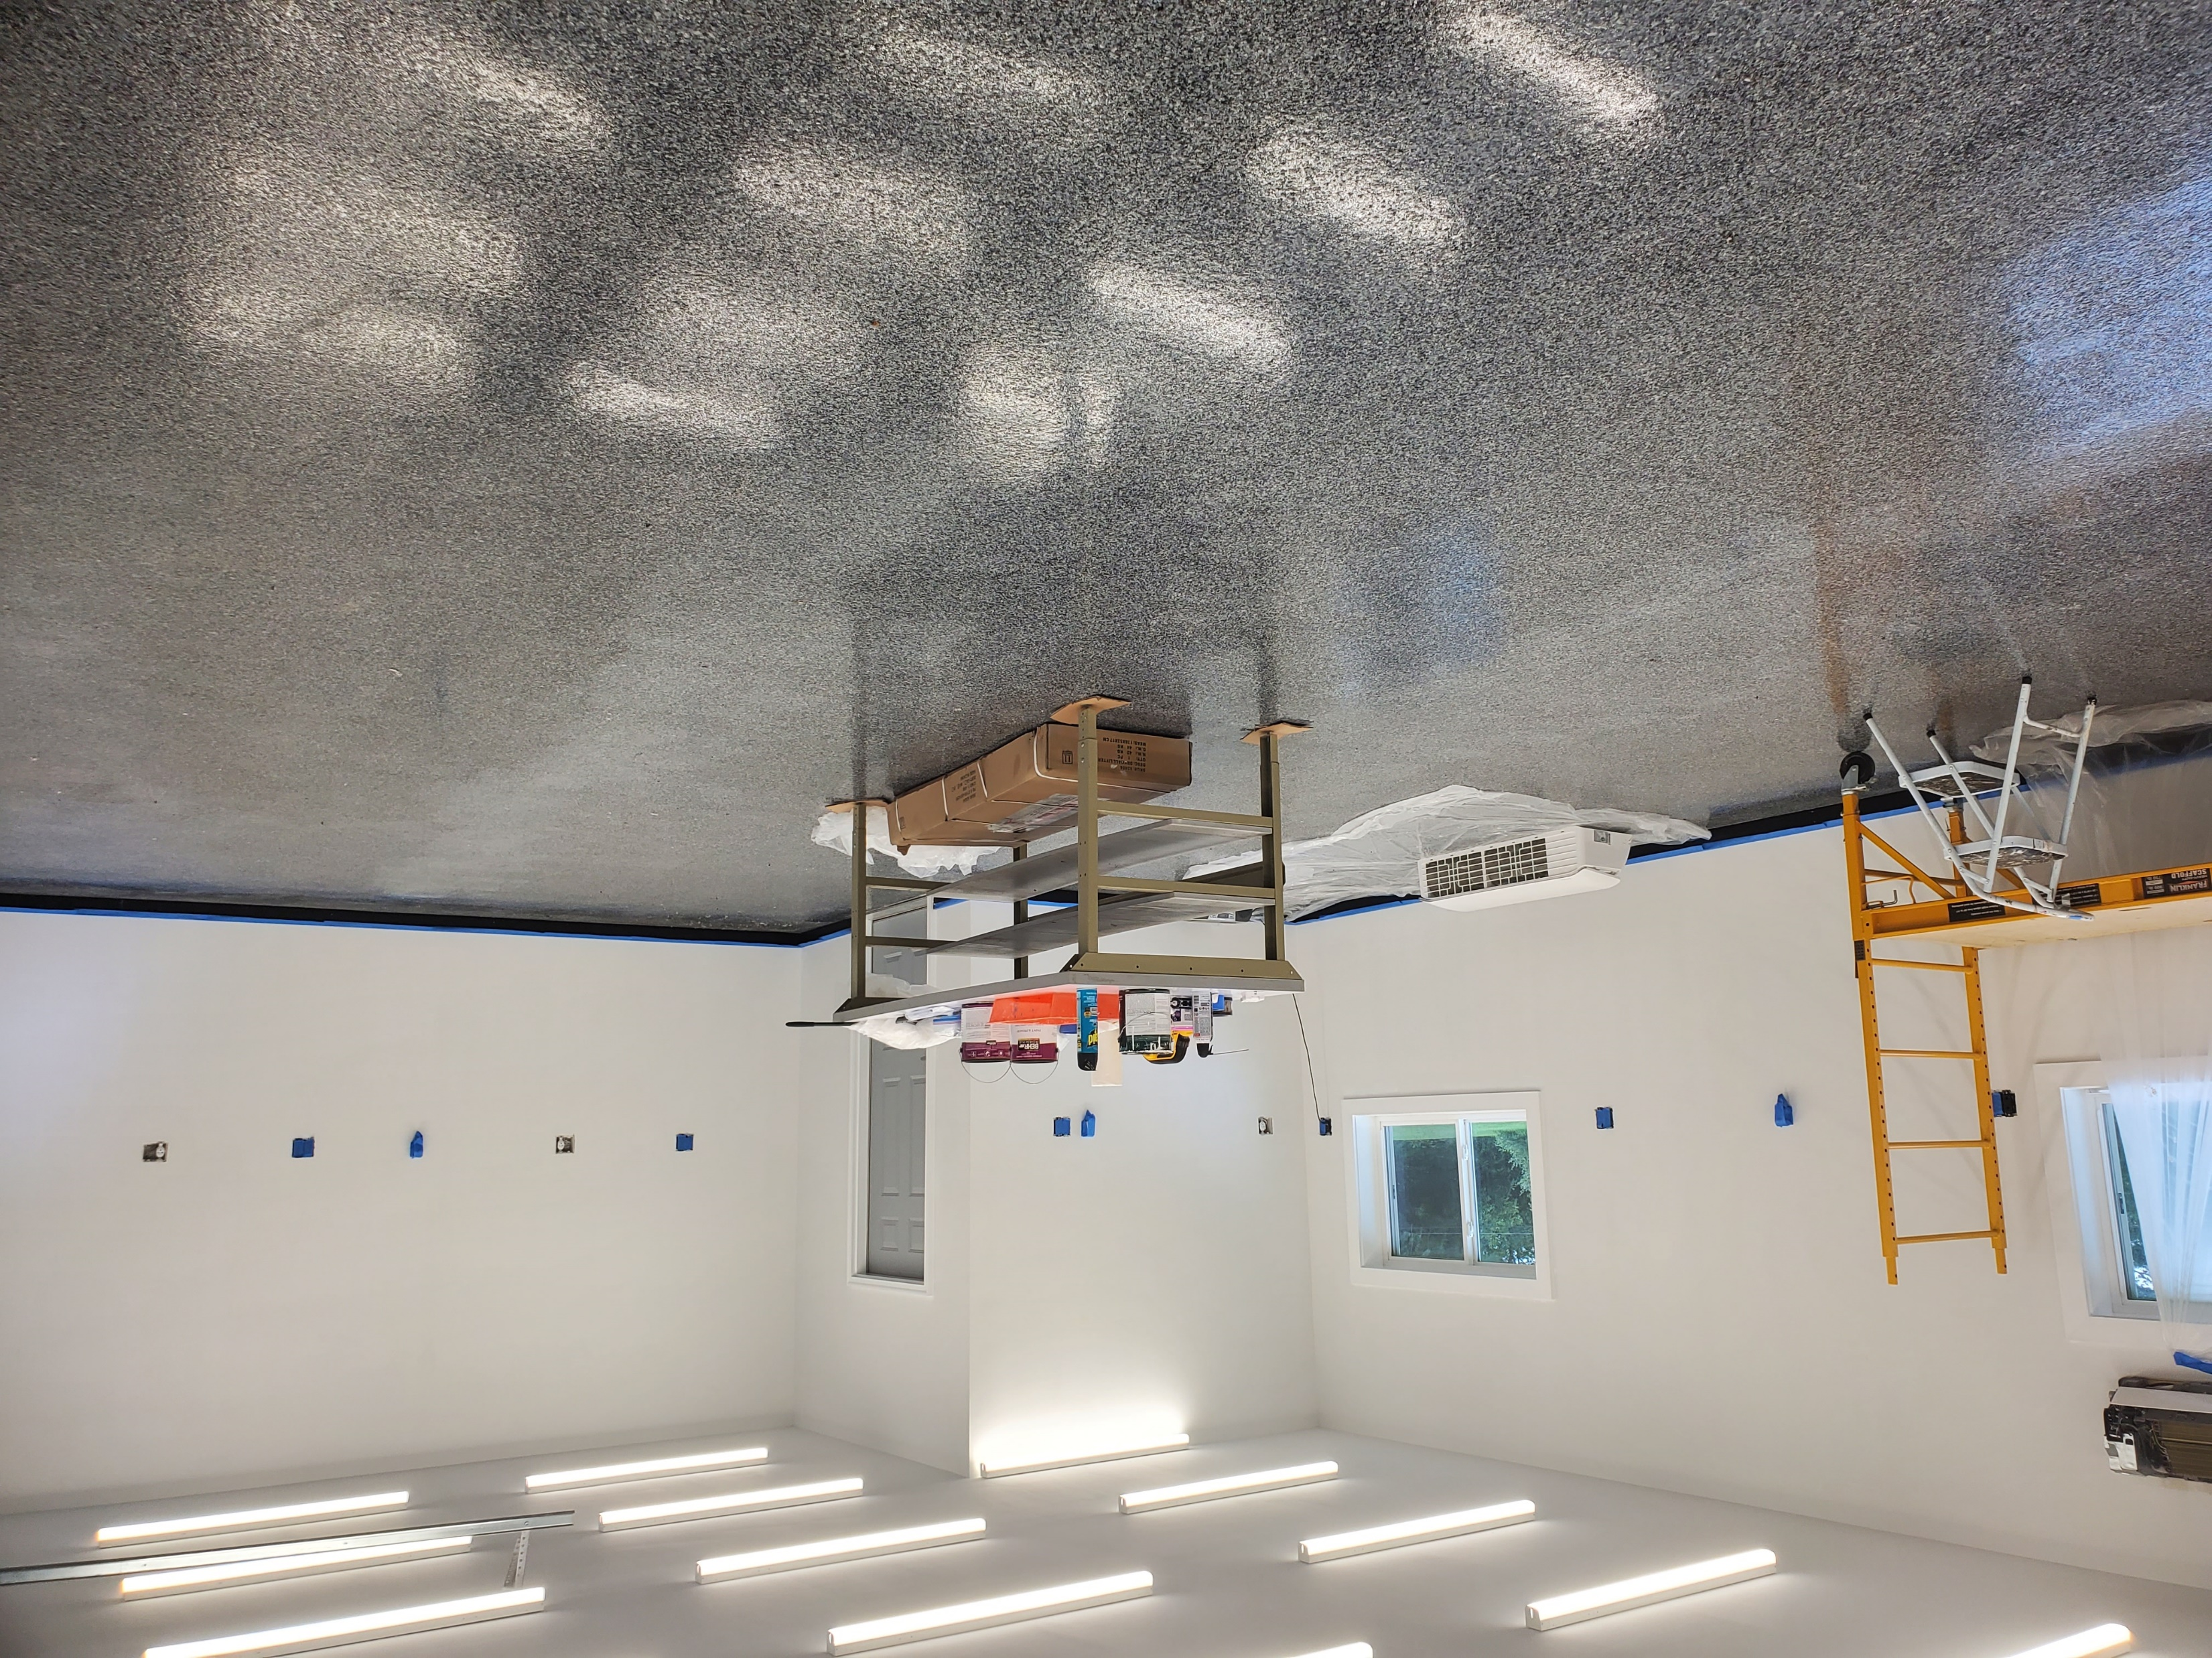
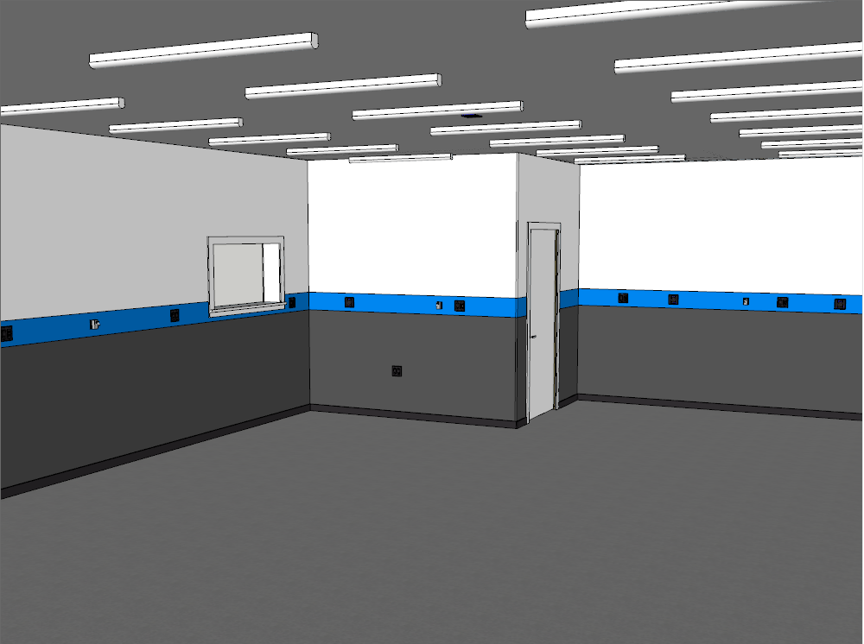
The Shop

Slide 20
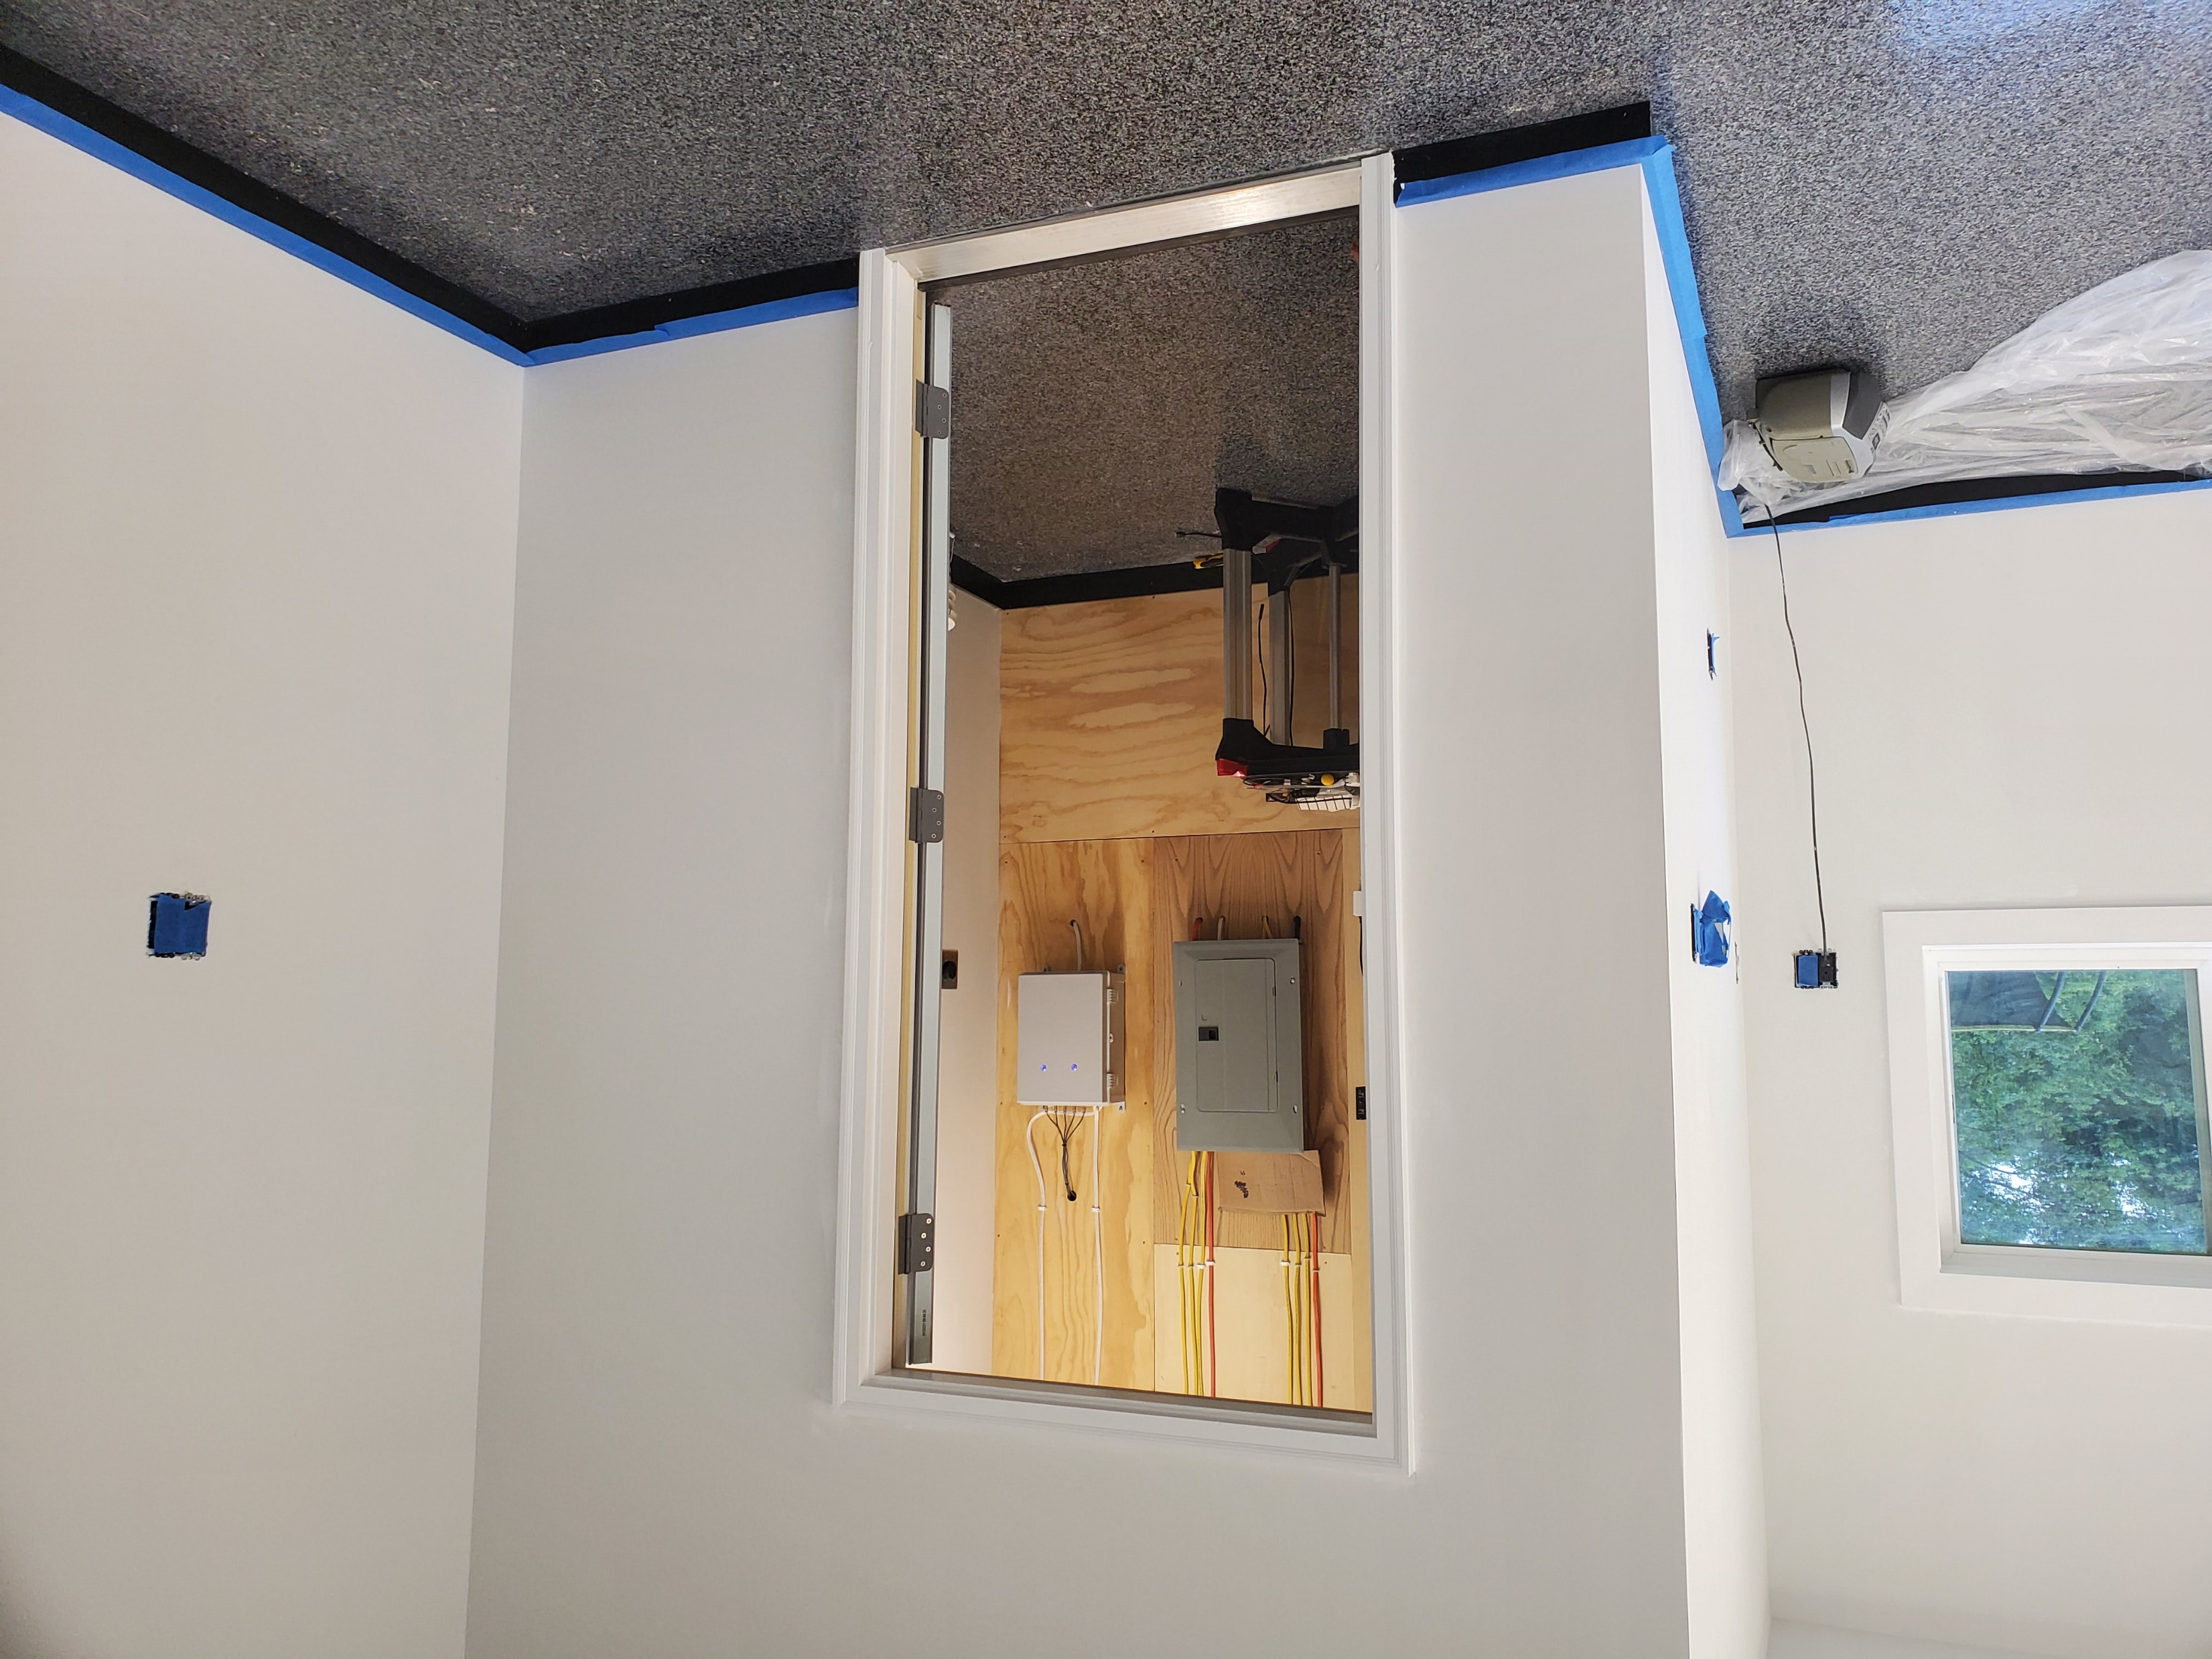
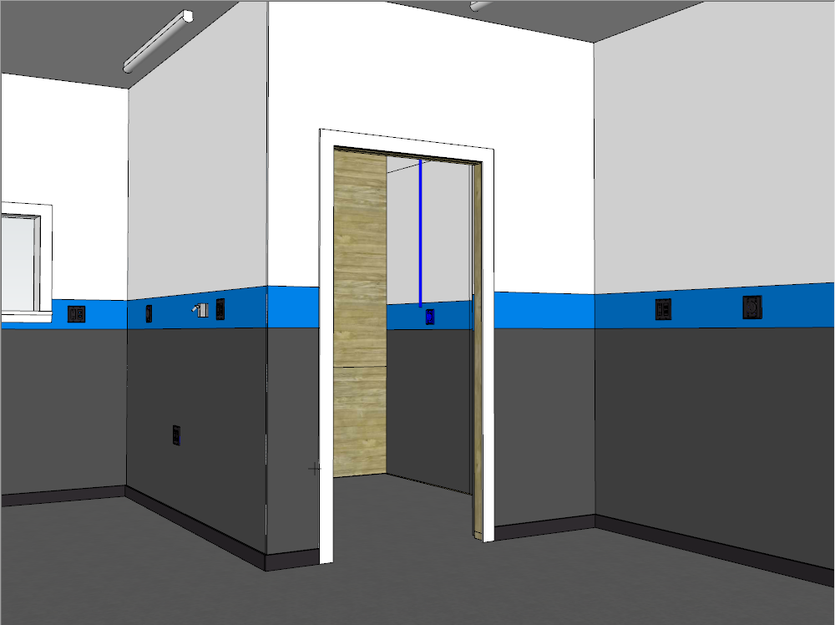
The Shop

Slide 21
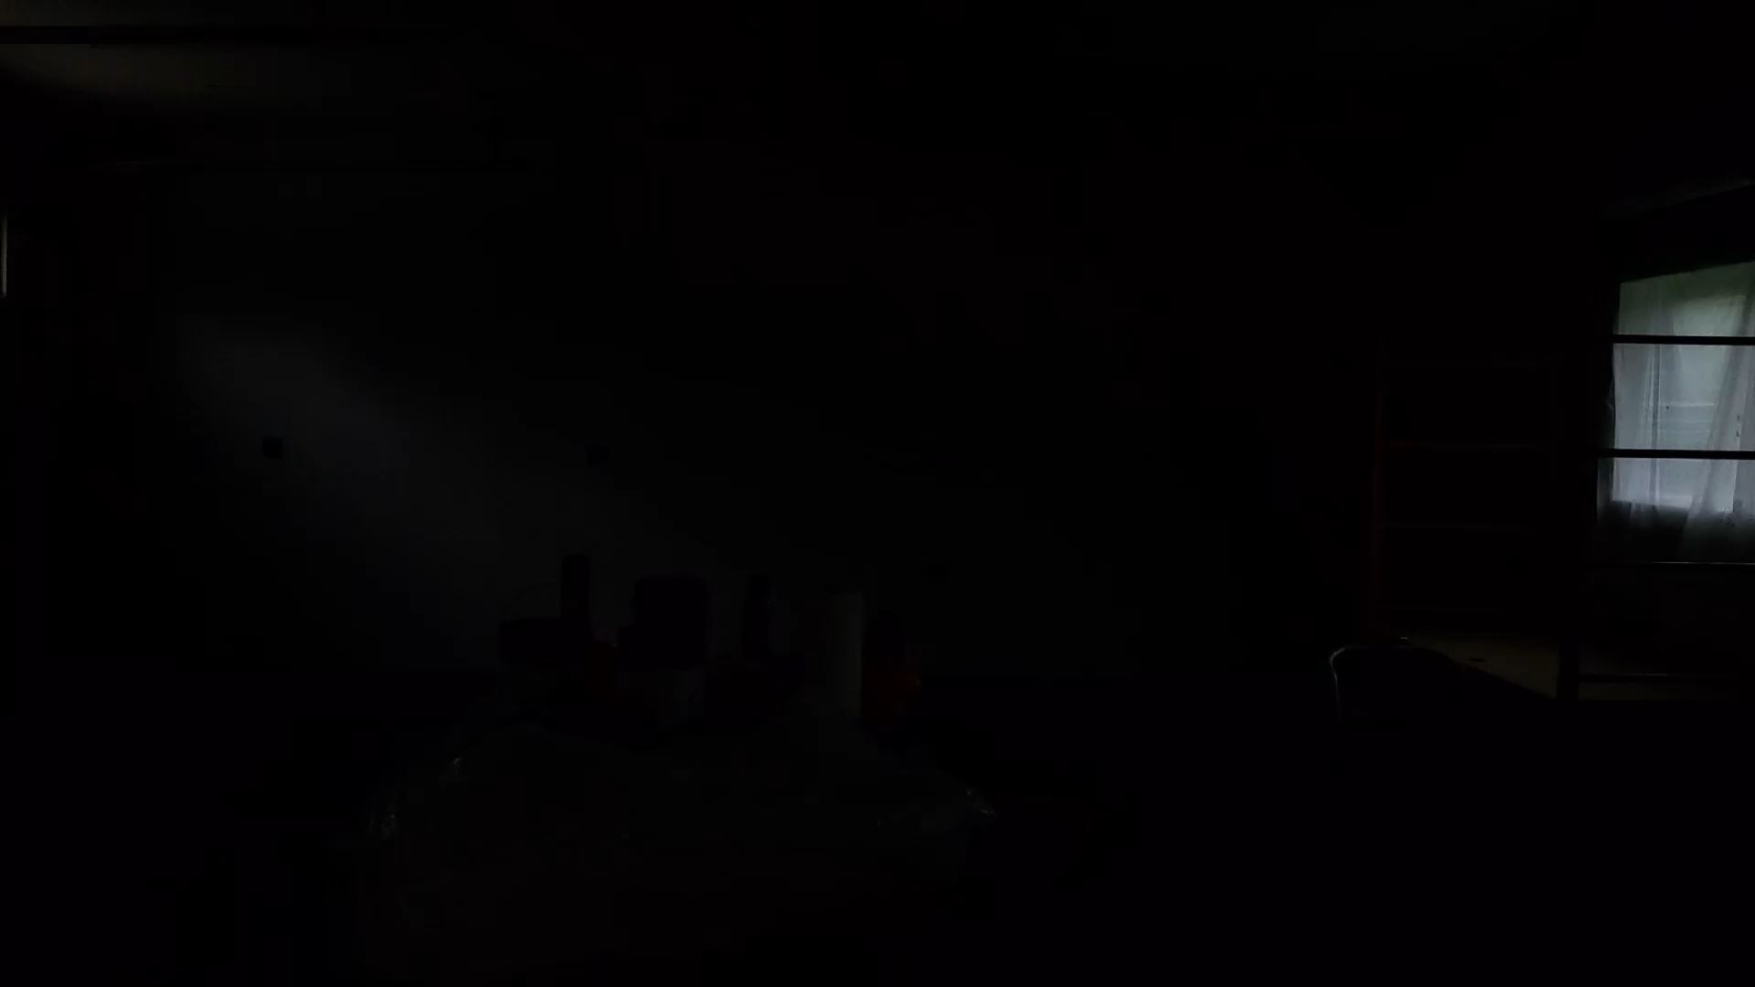
The Shop

Slide 22
Wrap up

